Slide 1
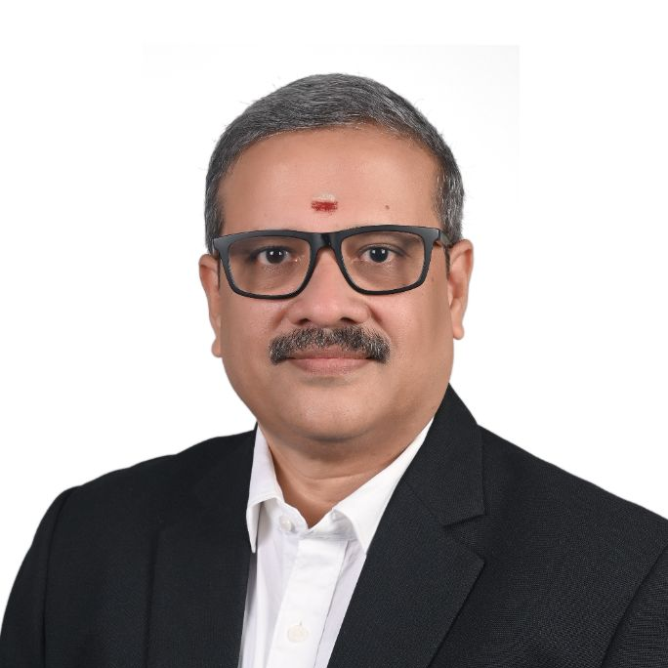



RAJKUMAR MEENAKSHISUNDARAM
CFO | Transformational Leader | Independent Director | Strategic Business Partner
+91 9363634537 / 9840764537
rajkumar@maathavam.com
rajkumar@sumedhas.com
www.linkedin.com/in/rajkumar-meenakshisundaram
CFO ADVISORY & LEADERSHIP
EXECUTIVE SUMMARY
Transformational finance leader with 29+ years across Consulting, Cognizant, Shell, Standard Chartered, Maersk, and Agility, holding FCA, ICWA, CMA & CFM (US), Six Sigma, Digital Transformation, and Independent Director certifications.
Combines strategic vision with execution excellence, serving as trusted FCFO and enabler to CXOs supporting organizational transformation and sustainable growth.
FCFO roles across MNCs and Indian organizations supporting Acquisitions, Transformation, Cash flow optimization, Advisory, Organizational restructuring and effectiveness, Compliance, and Business Intelligence—serving senior executives as a sounding board and objective challenger in strategic decision-making.
Strategic business partner architect who elevates shared services and finance teams from transactional to value-creating enablers, delivering measurable ROI through cost optimization, automation, and Six Sigma re-engineering.
Turnaround specialist transforming underperforming operations into high-performance teams while navigating complex mergers, including the successful DSV Panalpina-Agility integration. Builds resilient, scalable teams and establishes governance frameworks enabling operational excellence and competitive advantage.

Slide 2




STRATEGIC CFO BUSINESS LEADERSHIP
VALUE CREATION | TRANSFORMATION | EXCELLENCE | TALENT DEVELOPMENT
Establishes trusted C-suite & stakeholder partnerships through transparent communication, proactive resolution, and strategic initiatives aligned with organizational objectives.
Drives digital transformation, process re-engineering, and performance excellence, delivering optimal cost structures while maintaining service quality.
Builds high-performance teams, implementing competency frameworks that ensure sustainable knowledge transfer and operational continuity and effectiveness

